Slide 1
CSE 405
I/O Interfacing
Osama Hosameldeen
Spring 2021
Lecture 7: The Interrupt System
Notes:
All coming lectures will cover the “I/O Techniques and Buses” part

Slide 2
Contents
Interrupts
Interrupt vectors
Hardware interrupts.
© 2015 ELSIVER, All rights reserved. compiled by Dr. Osama Hosameldeen

Slide 3
Interrupt Vectors
© 2015 ELSIVER, All rights reserved. compiled by Dr. Osama Hosameldeen

Slide 4
Interrupts
We have seen previously that interrupt is a mechanism by which the CPU can handle I/O services.
While executing the main thread, the CPU saves current registers and jump to the interrupt handler. Handle it and revert back to the CPU’s main thread again.
The interrupt handler performs whatever action is necessary (e.g. reading a key code from the keyboard or digitized data from an ADC)
© 2015 ELSIVER, All rights reserved. compiled by Dr. Osama Hosameldeen

Slide 5
Interrupts
Interrupts transfer control from the running code to an interrupt handler
  Each interrupt is assigned a number
  Number acts as an index into the Interrupt Vector Table
  Table maps interrupt numbers to handlers
Interrupts cause a context switch
  State of the CPU must be saved before the switch…
  … and restored after the handler completes
Main Memory
0xFFFF
0x01 Handler
0xA146
0x00FF
Interrupt Number | Pointer to Handler
0x02 | 0x0000
0x01 | 0xA146
Interrupt Vector
0x0000

Slide 6
Interrupts
User
Program
Fetch instruction at IP
ld
add
st
mul
ld
sub
bne
add
jmp
…
Decode the fetched instruction
Save context
IP
Get INTR ID
Execute the decoded instruction
Lookup ISR
Advance IP to next instruction
Execute ISR
IRQ?
yes
IRET
no

Slide 7
The type of interrupt in this lecture
If you are application programmer, you will use real-mode to write IO application for example, under DOS operating system.
In 32-bit protected-mode operating systems, such as Windows NT, interrupt handling can be performed only by highly privileged code – i.e. by operating-system code or kernel-mode device drivers.
We will focus on the first approach, but most of the concepts also will be applied on ring0 kernels.
© 2015 ELSIVER, All rights reserved. compiled by Dr. Osama Hosameldeen

Slide 8
Types of interrupts
The PC supports four different types of control-transfer mechanisms that are all loosely referred to as interrupts.
Non-Maskable Interrupt (NMI), (HW)
External interrupts, (HW)
Software interrupts, (SW)
Processor exceptions.(SW)
Software interrupts and external hardware interrupts are relevance to DA&C applications programs.
You also should be aware of NMI and exceptions for use with time-critical applications or systems software
© 2015 ELSIVER, All rights reserved. compiled by Dr. Osama Hosameldeen

Slide 9
Interrupt Processing in
Real Mode
Uses an interrupt vector table that stores pointers to the associated interrupt handlers.
This table is located at base address zero.
  Each entry in this table consists of a CS:IP pointer to the associated interrupt subroutine
Each entry or vector requires four bytes:
  Two bytes for specifying segment CS
  Two bytes for the offset IP
Up to 256 interrupts are supported (0 to 255). (see next slides)

Slide 10
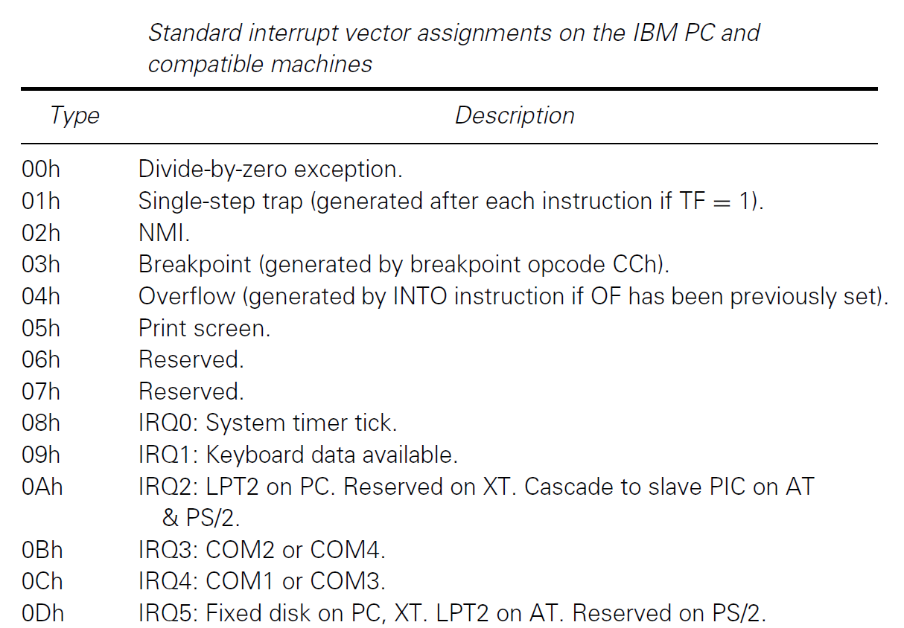
Standard interrupt vector usage
© 2015 ELSIVER, All rights reserved. compiled by Dr. Osama Hosameldeen

Slide 11
Interrupt Number to Vector
Translation
Interrupt numbers range from 0 to 255
Interrupt number acts as an index into the interrupt vector table
Since each vector takes 4 bytes, interrupt number is multiplied by 4 to get the corresponding ISR pointer
Example
For interrupt 2, the memory address is
2 ∗ 4 = 8H
The first two bytes at 8H are taken as the offset value
The next two bytes (i.e., at address AH) are used as the CS value
2005
To be used with S. Dandamudi, “Introduction to Assembly Language Programming,” Second Edition, Springer, 2005.
S. Dandamudi
Chapter 15: Page <number>

Slide 12
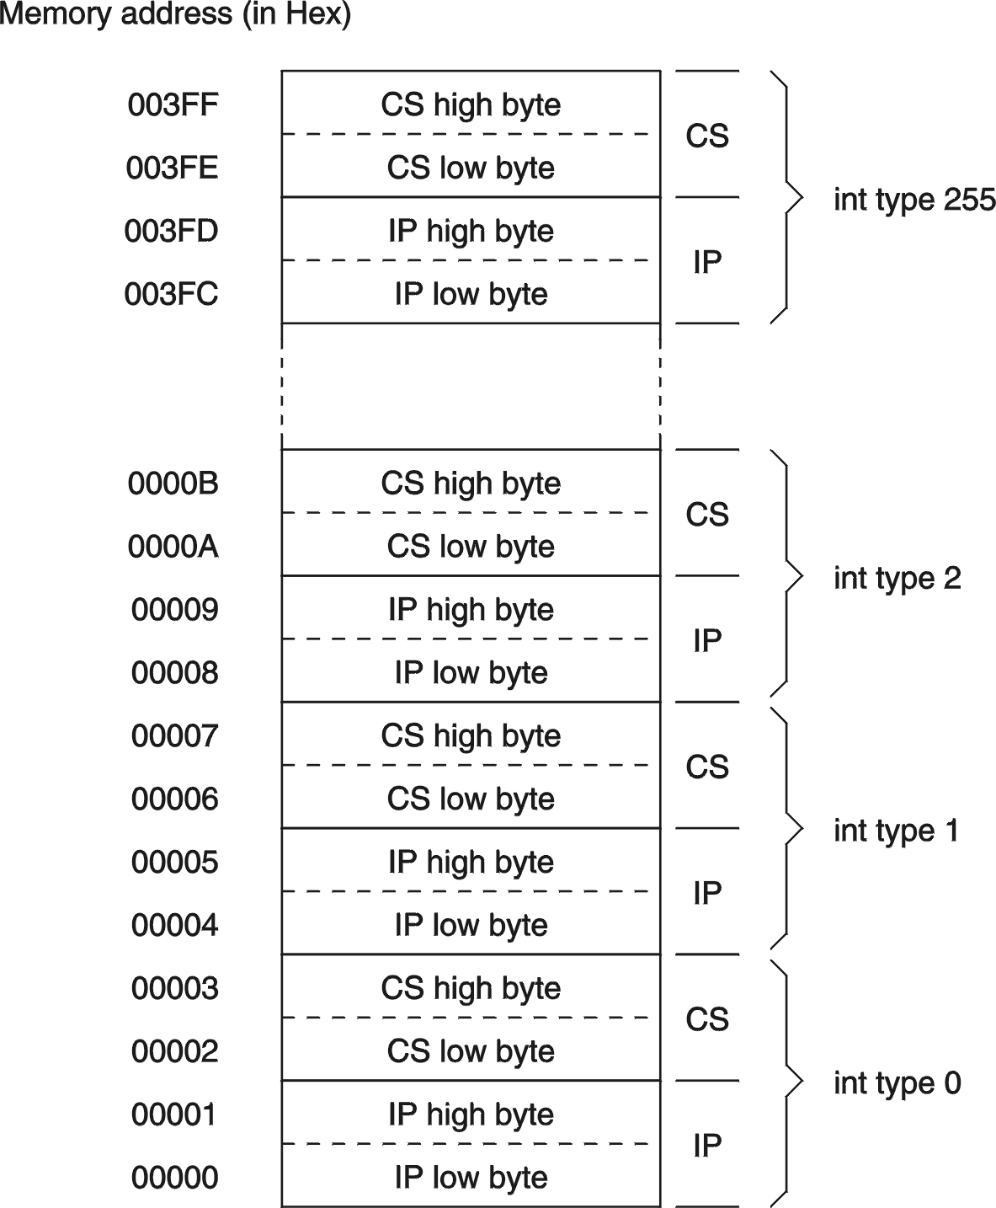
Interrupt Vector Table
2005
To be used with S. Dandamudi, “Introduction to Assembly Language Programming,” Second Edition, Springer, 2005.
S. Dandamudi
Chapter 15: Page <number>

Slide 13
What Happens When An Interrupt
Occurs?
Push flags register onto the stack
Clear interrupt enable and trap flags
  This disables further interrupts
  Use sti to enable interrupts
Push CS and IP registers onto the stack
Load CS with the 16-bit data at memory address
    interrupt-type ∗ 4 + 2
Load IP with the 16-bit data at memory address
    interrupt-type ∗ 4

Slide 14
Returning From An ISR
As in procedures, the last instruction in an ISR should be iret
The actions taken on iret are:
  pop the 16-bit value on top of the stack into IP register
  pop the 16-bit value on top of the stack into CS register
  pop the 16-bit value on top of the stack into the flags register
As in procedures, make sure that your ISR does not leave any data on the stack (i.e., match your push and pop operations within the ISR)
2005
To be used with S. Dandamudi, “Introduction to Assembly Language Programming,” Second Edition, Springer, 2005.
S. Dandamudi
Chapter 15: Page <number>

Slide 15
A Typical ISR Structure
Just like procedures, ISRs should end with a return statement to return control back
The interrupt return (iret) is used of this purpose
  ;save the registers used in the ISR
  sti ;enable further interrupts
  . . .
  ISR body
  . . .
  ;restore the saved registers
  iret ;return to interrupted program
2005
To be used with S. Dandamudi, “Introduction to Assembly Language Programming,” Second Edition, Springer, 2005.
S. Dandamudi
Chapter 15: Page <number>
Notes:
Sti : set interrupt flag.

Slide 16
Hardware Interrupts
© 2015 ELSIVER, All rights reserved. compiled by Dr. Osama Hosameldeen

Slide 17
The FLAGS register
Status-flags
O
F
D
F
I
F
T
F
S
F
Z
F
0
A
F
0
P
F
1
C
F
Control-flags
Legend: ZF = Zero Flag
SF = Sign Flag
CF = Carry Flag
PF = Parity Flag TF = Trap Flag
OF = Overflow Flag IF = Interrupt Flag
AF = Auxiliary Flag DF = Direction Flag

Slide 18
Types of hardware interrupts
The processor is equipped with two pins known as NMI and INTR. Signals present on either of these pins can interrupt the processor.
The INTR line carries external hardware interrupt requests,
The NMI line carries non-maskable interrupt requests.
In the PC, a number of different subsystems and peripheral components are able to assert the NMI or INTR lines whenever they require attention from the processor.
© 2015 ELSIVER, All rights reserved. compiled by Dr. Osama Hosameldeen

Slide 19
External hardware interrupts
It is important to stop interrupts because they may share a critical section.
The processor shall mask external interrupts by using CLI (clear interrupt flag) instruction.
Processor's CLI will reset IF (interrupt flag) and disable further interrupts that received on INTR line.
By this means it is possible to prevent interrupts from occurring and thereby to protect critical portions of the code
After the critical section, interrupts is enabled again by issuing the STI instruction which sets IF back to 1
© 2015 ELSIVER, All rights reserved. compiled by Dr. Osama Hosameldeen

Slide 20
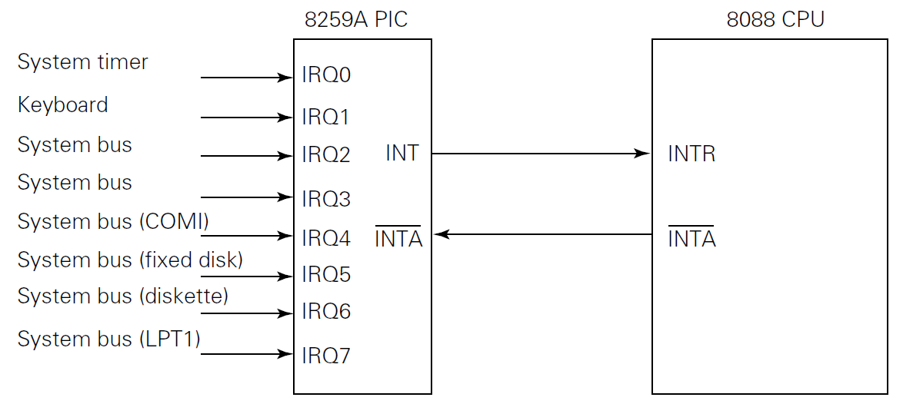
Introduction to the 8259A PIC
(programmable Interrupt Controller)
The external hardware interrupt system was managed on the original IBM PC by an Intel 8259A Programmable Interrupt Controller (PIC) as shown in Figure
© 2015 ELSIVER, All rights reserved. compiled by Dr. Osama Hosameldeen

Slide 21
Introduction to the 8259A PIC
(programmable Interrupt Controller)
INTR is enabled if PIC has received a request for interrupt from any of the 8 peripherals IRQ0-IRQ7
PIC is working by default in accordance with BIOIS startup code, it is already programmed, but can be reprogrammed from within high privileged mode of Operating System.
The priorities are given to the interrupts, so IRQ0 is the highest priority and IRQ7 is the lowest priority. With many requests, the processor will receive interrupts requests according their priorities.
© 2015 ELSIVER, All rights reserved. compiled by Dr. Osama Hosameldeen

Slide 22
Introduction to the 8259A PIC
Registers
There are 3 types of registers in PIC (next slide)
IQR lines are directly latched to IRR registers
IRR is connected to IMR which contains user defined bit-pattern. When IRR is 0 this means the corresponding interrupt is enabled
The interrupt signal is transferred to priority resolver which defines priorities of interrupts that are pending and waiting for the service.

Slide 23
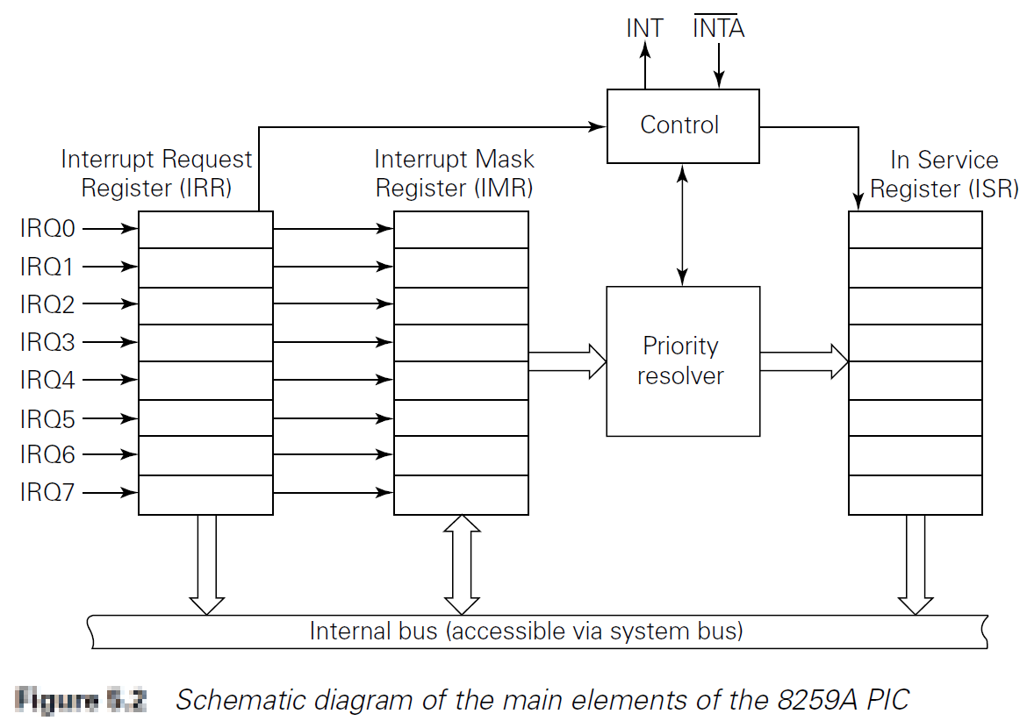
Introduction to the 8259A PIC
Registers

Slide 24
Introduction to the 8259A PIC
Registers
Accordingly, the INT line - which is connected to INTR of the processor, is enabled and hence the interrupt sequence is enabled.
The corresponding ISR register is set to 1 to show that the interrupt is currently in service.
The three registers IRR, IMR and ISR can be all read to know interrupt status. In addition, the programmer can write in the IMR to enable or disable specific interrupt line.

Slide 25
Introduction to the 8259A PIC
Interrupt sequence
The sequence of interrupt is initiated when a device needs a service and ends when the device is served.
When the device needs service, it initiates the allotted IRQ high (IRQ=1)
If the corresponding IIR is 0, the signal is passed to the priority resolver.
If no other devices are waiting or currently in service, PIC will initiate the processor’s INTR.
  If there are other devices with higher priority in service or pending, PIC will wait until other devices finishes

Slide 26
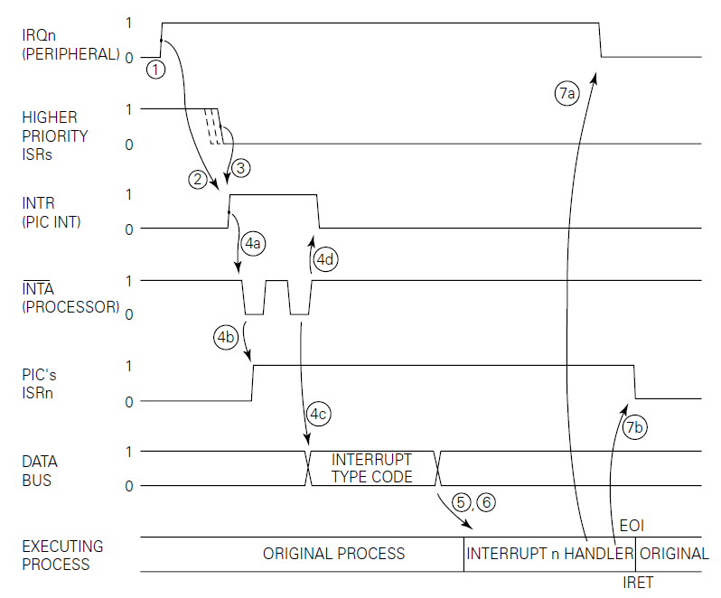
Introduction to the 8259A PIC
Interrupt sequence

Slide 27
Introduction to the 8259A PIC
Interrupt sequence
When the processor receives the INTR signal from the PIC it asserts the PIC’s Interrupt Acknowledge (INTA) line twice in succession.
  The PIC responds to the first INTA cycle by setting the appropriate bit of the ISR and clearing the corresponding IRR bit
  The second INTA cycle causes the PIC to transfer an 8-bit Interrupt Type Code to the processor via the data bus
  The processor retrieves the Interrupt Type Code from the data bus and multiplies it by four to calculate the offset into the IVT of the interrupt vector that it will use.

Slide 28
Introduction to the 8259A PIC
Interrupt sequence
The processor retrieves the address of the interrupt handler from the interrupt vector and, by placing this address into its CS:IP registers, effectively transfers control to the beginning of the interrupt handler.
The interrupt handler performs whatever actions are necessary in order to respond to the peripheral device’s interrupt request.
The EOI command issued by the handlers, causes the ISR to be reset, allowing further interrupt requests of an equal or lower priority to proceed

Slide 29
Introduction to the 8259A PIC
Master Slave PIC’s
In order to expand their interrupt processing capability from 8 to 15 IRQ lines, master-slave configuration can be used.
This requires the BIOS’s Power-On Self Test (POST) routines to initialize the PICs in a slightly different manner so that they will operate as a master and slave.
The slave’s INT output line is fed to the IRQ2 input of the master PIC. In this way any interrupt requests occurring on IRQ8–IRQ15 result in an interrupt being signaled on the master PIC’s level 2 input.

Slide 30
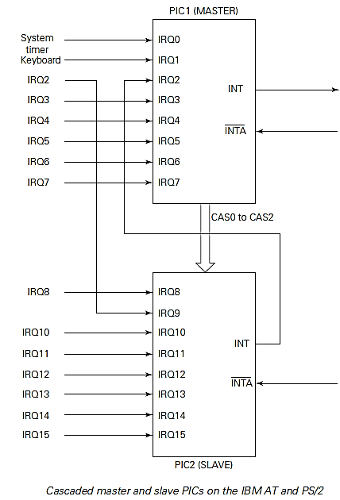
Introduction to the 8259A PIC
Master Slave PIC’s
When the slave receives an interrupt request, it prioritizes it in the same way as previously described and asserts its INT line.
This is detected by the master PIC on its IRQ2 line.
The master then prioritizes this interrupt request and asserts the processor’s INTR pin.
When the processor responds with two INTA pulses, the master PIC effectively passes control to the slave by means of the CAS0 to CAS2 lines. These enable the slave and cause it (rather than the master PIC) to place an Interrupt Type Code (usually in the range 70h to 77h) on the data bus during the second INTA cycle.

Slide 31
Introduction to the 8259A PIC
Non-Maskable Interrupt (NMI)
Notify the processor when some critical event, such as a hardware failure, has been detected.
There are three possible sources of NMIs:
  RAM parity failure,
  I/O channel error or
  a numeric coprocessor error.
One important difference between NMIs and external hardware (INTR) interrupts is that the processor does not attempt to retrieve an Interrupt Type Code from the data bus.
Instead, it always uses interrupt type 2 to service the NMI. This is a fixed feature of the processor and cannot be changed by the programmer.

Slide 32
Introduction to the 8259A PIC
Non-Maskable Interrupt (NMI)
NMIs with highest priority of all hardware interrupts, it confirms immediate response to a pending error condition. The only conditions that can delay execution of an NMI are:
The NMI has been disabled by software (e.g. by code that reads the CMOS RAM or Clock).
The processor is responding to a higher priority interrupt (such as an exception).
The processor has begun execution of an instruction that changes the SS (stack segment) register. In this case the NMI will not be recognized until after the following instruction has been executed.

Slide 33

Reference
Kevin James - PC Interfacing and Data Acquisition Techniques for Measurement, Instrumentation and Control. (2000)
© 2015 ELSIVER, All rights reserved. compiled by Dr. Osama Hosameldeen

